Slide 1

Heart Rate Monitoring using Machine Learning
Capstone Project Phase A – 61998
24-1-R-8
By:
Ali Mohsen
Mohammad Khamaisy
Supervisor
Zeev Frenkel

Slide 2
Agenda
Introduction
Why?
Our solution
How it works?
Algorithms
Architecture
Interface
Testing The Application
Problems we may face

Slide 3

Introduction
Heart rate is a critical indicator of overall cardiovascular health and fitness
Many people monitor their heart rate
There are many heart rate applications available
Abnormalities detection is still usually not personalized to the user
=> false positive and false negative results
3

Slide 4
Why?
Automatically measurement of heart rate
User-activity-specific abnormalities detection
Smart alert system
Ability of system learning based on the data from the entire set of users

Slide 5
Our Solution
Heart Rate Monitoring application that combines wearable tech and machine learning.
It offers real-time heart rate tracking, detects irregularities.
Provides personalized insights

Slide 6
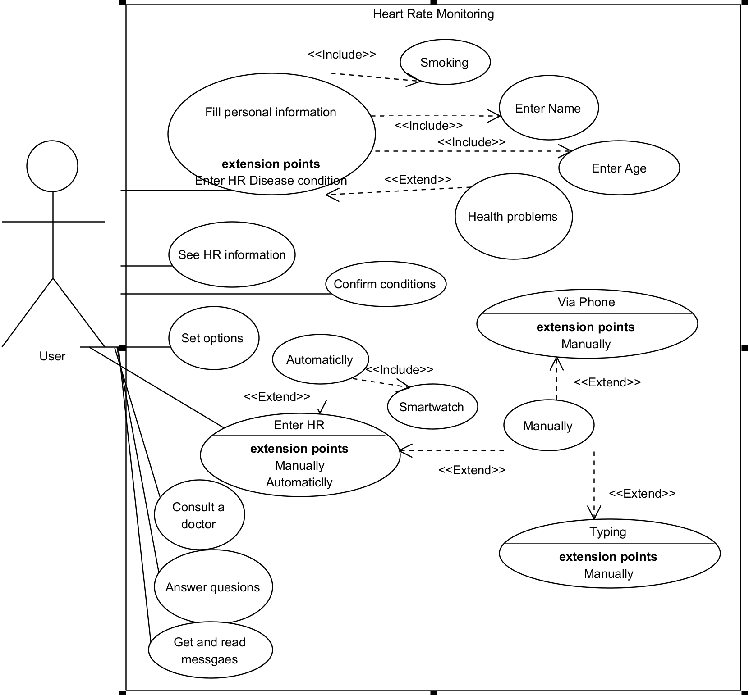
Use case:

Slide 7
How does It work?
Our application for smartphones:
Start with personal questions and a terms agreement
Automated heart rate monitoring via smartwatch or phone camera.
Half-automated monitoring of user activity
Storing the date in the database
Real time data processing and learning the system
Learning-based improvement of the alert system

Slide 8
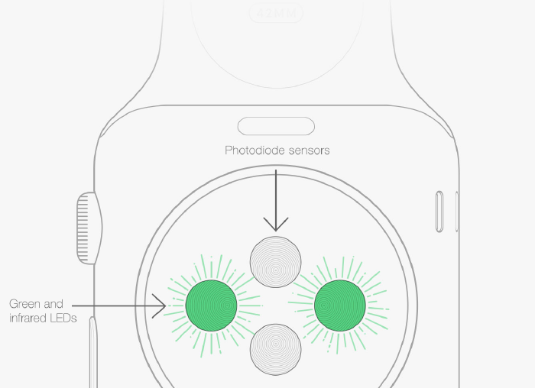
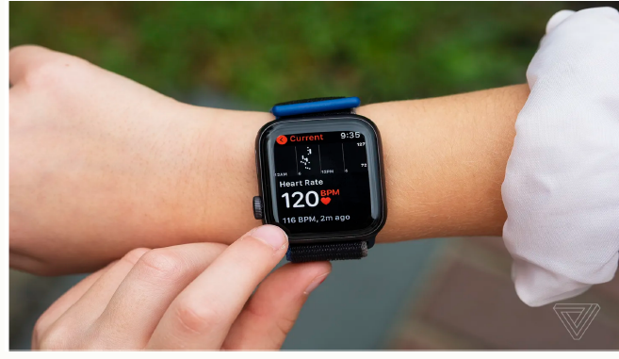
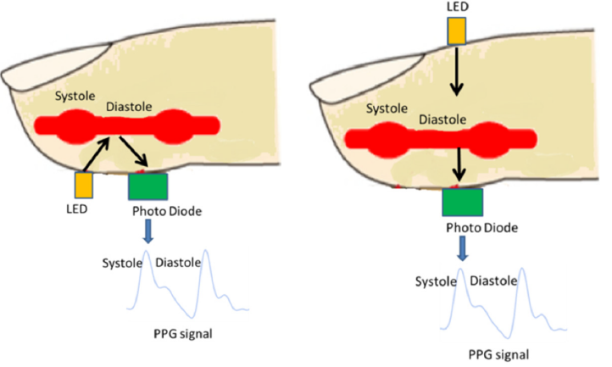
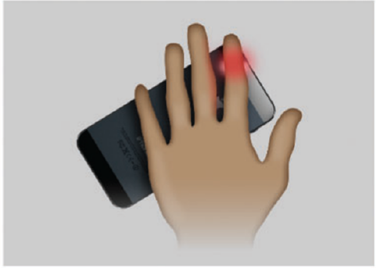
Sensors we use to collect the data
Our app uses PPG sensors, accelerometers, and ECG sensors

Slide 9
Data Base
Prefers to store DB in the server to increase learning efficiency
By default, with the absence of enough personalized data, uses data from “similar” users (based on a wide range of demographics, activity levels, and health conditions.
Employs a MongoDB for NoSQL Database, managed with PyMongo, to store and organize data.
Builds personalized models for better anomaly detection and insights.

Slide 10
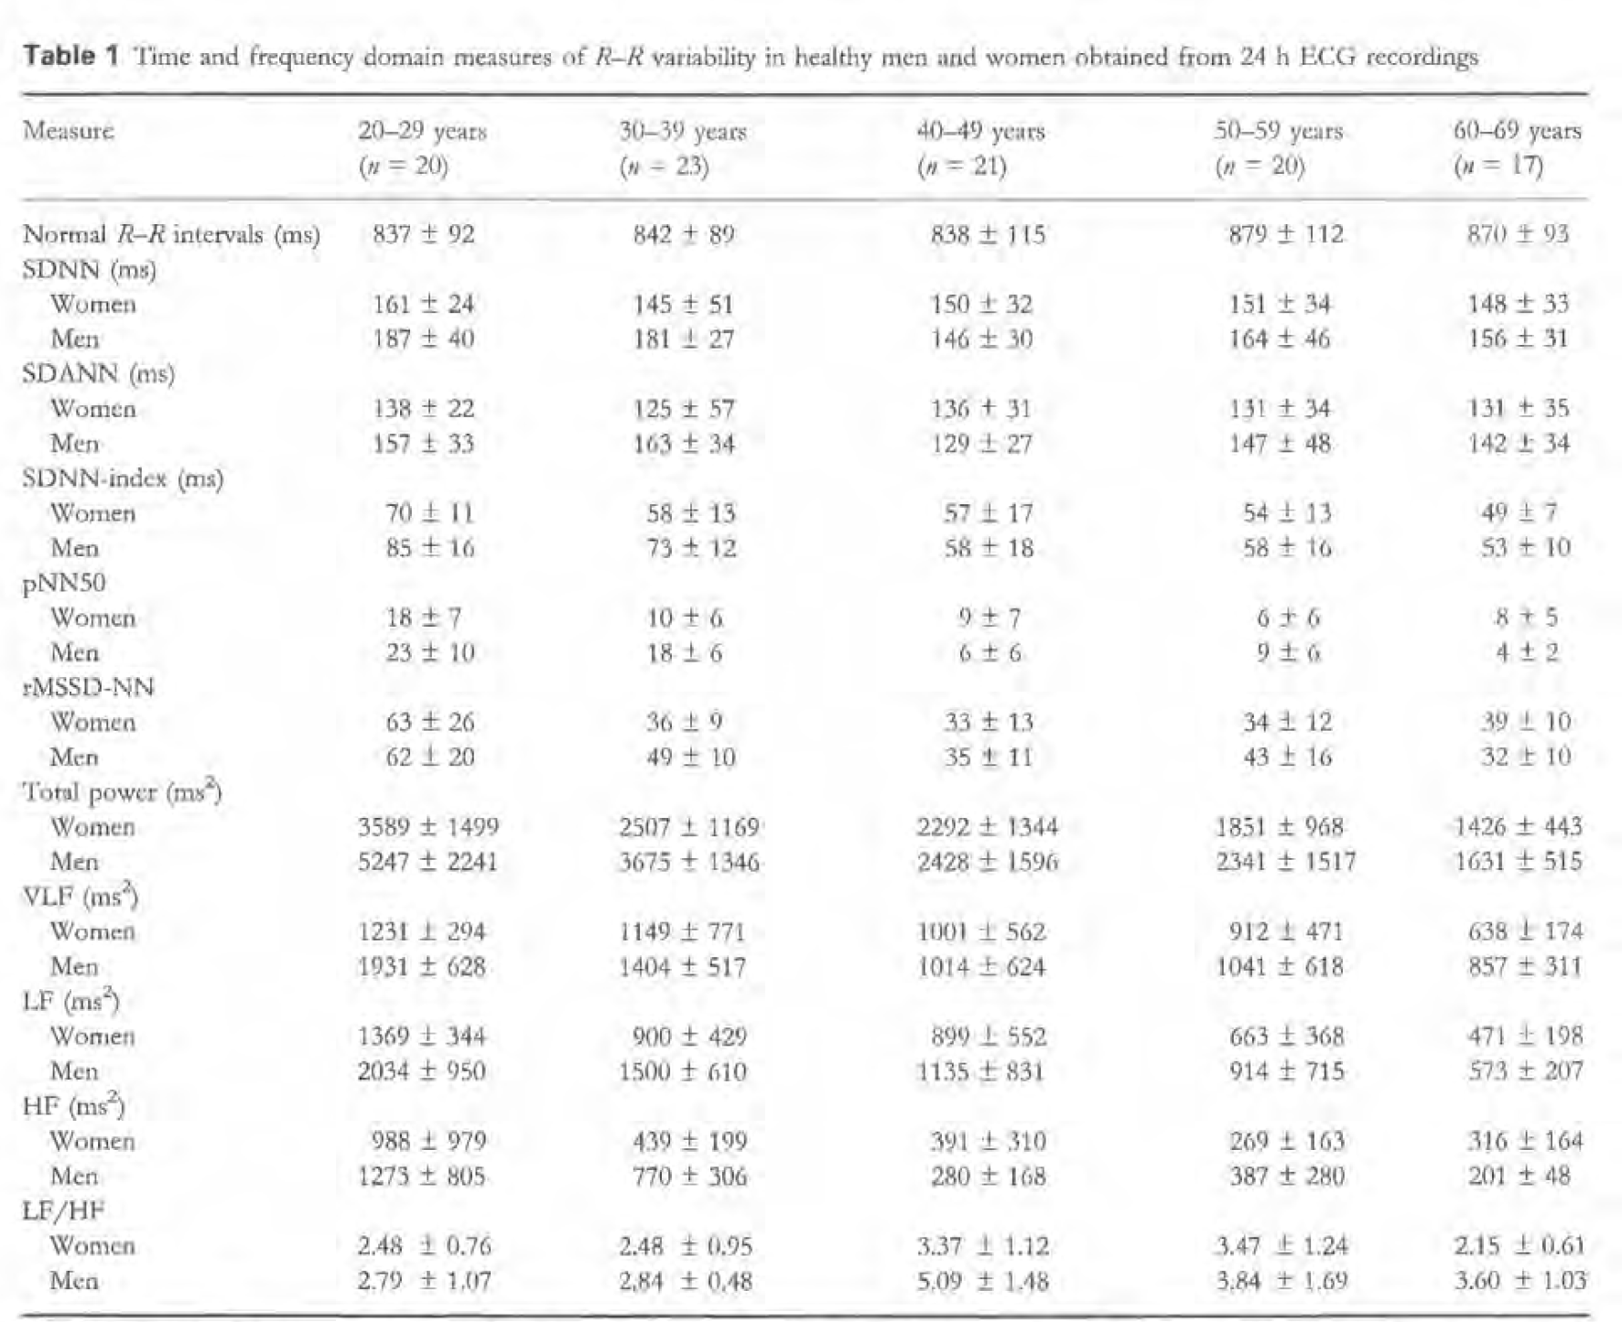
Heart rate data across various age groups and activities

Slide 11
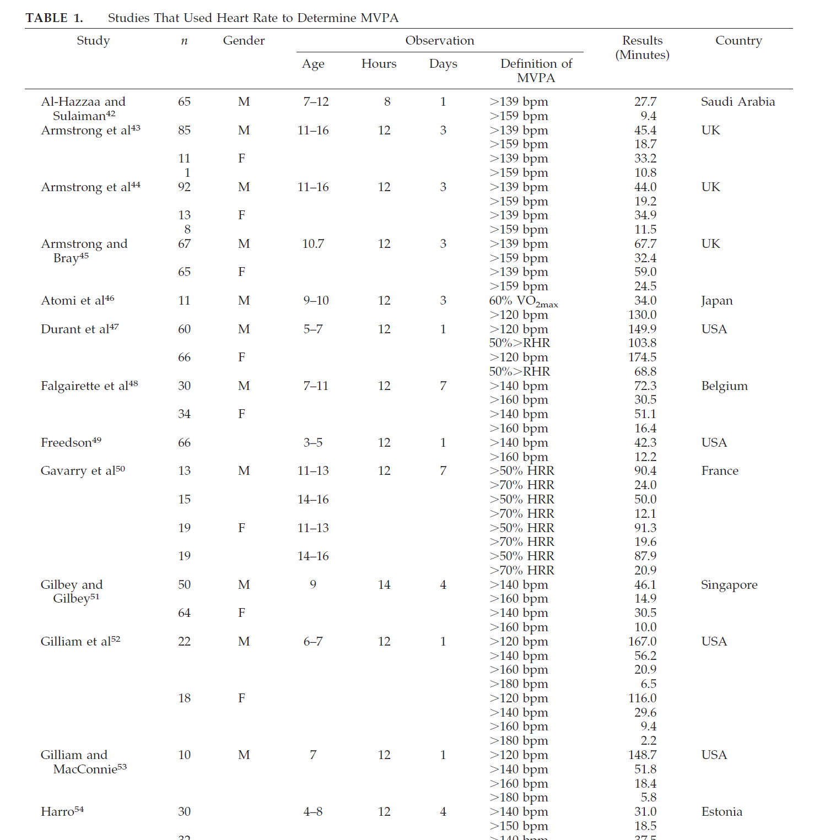

Slide 12
Algorithms: Time Series Forecasting
Analyze historical data to predict future values:
Early anomaly detection
Heart rate patterns for personalized insights
Proactive monitoring and alerting
Trend analysis for tracking cardiovascular health

Slide 13
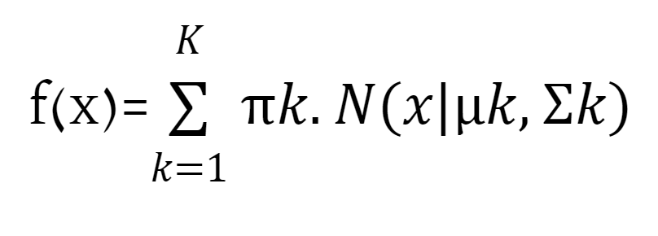
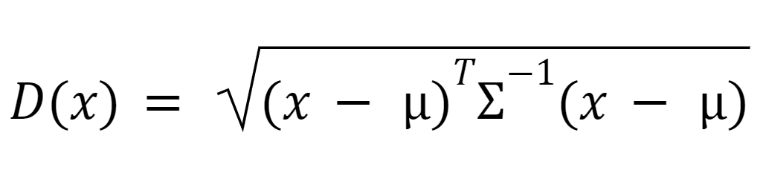
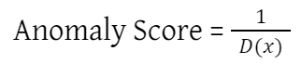
Algorithms: Anomaly Detection
Identify deviations from expected behavior:
Detecting irregular heart rate patterns
Personalized anomaly detection through user-specific pattern learning
Early warning system for timely interventions and preventive measures
Continuous, real-time monitoring to ensure no anomalies are missed

Slide 14
Algorithms: Efficient memory usage
LSTM recurrent neural network (RNN) architecture:
Handling noisy data
Isolation Forests:
Unsupervised learning: not requiring labeled data
Efficiency: low computational complexity suitable for real-time anomaly detection
One-Class SVMs:
Handling high-dimensional data: capturing complex patterns

Slide 15
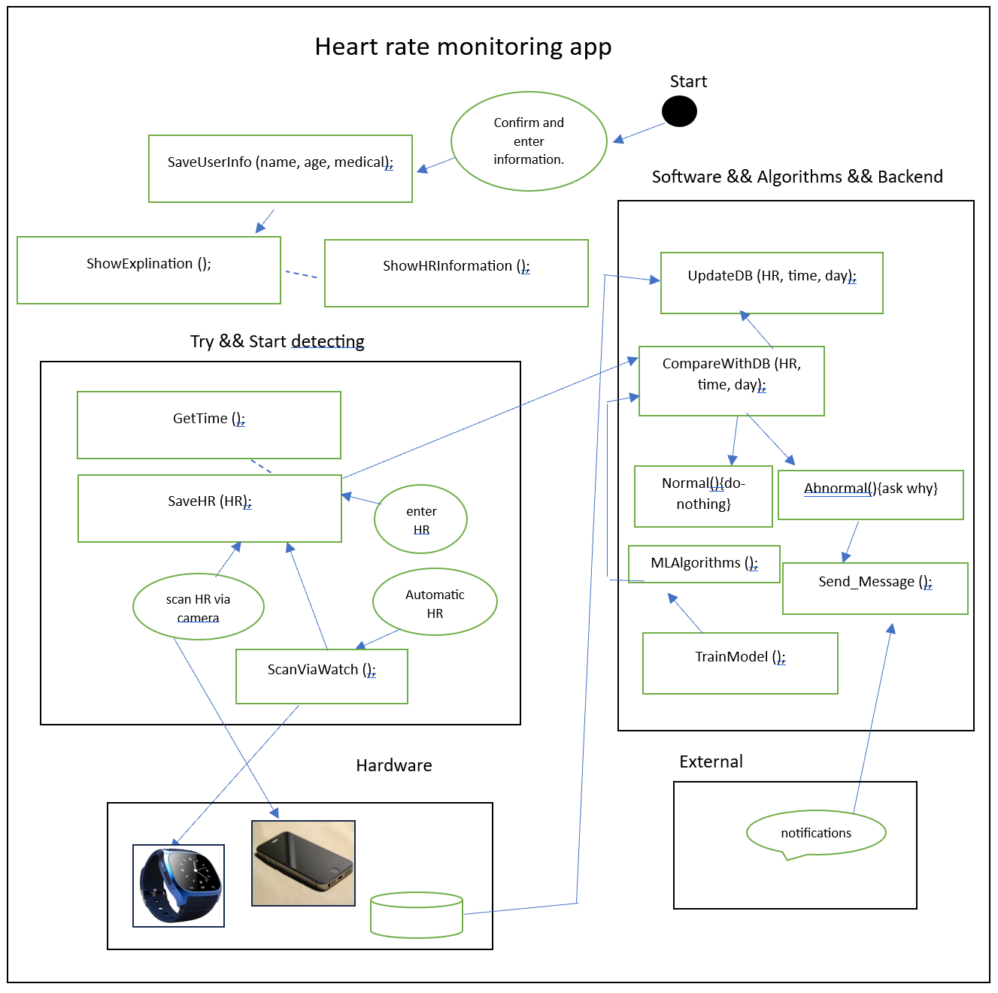
Architecture

Slide 16
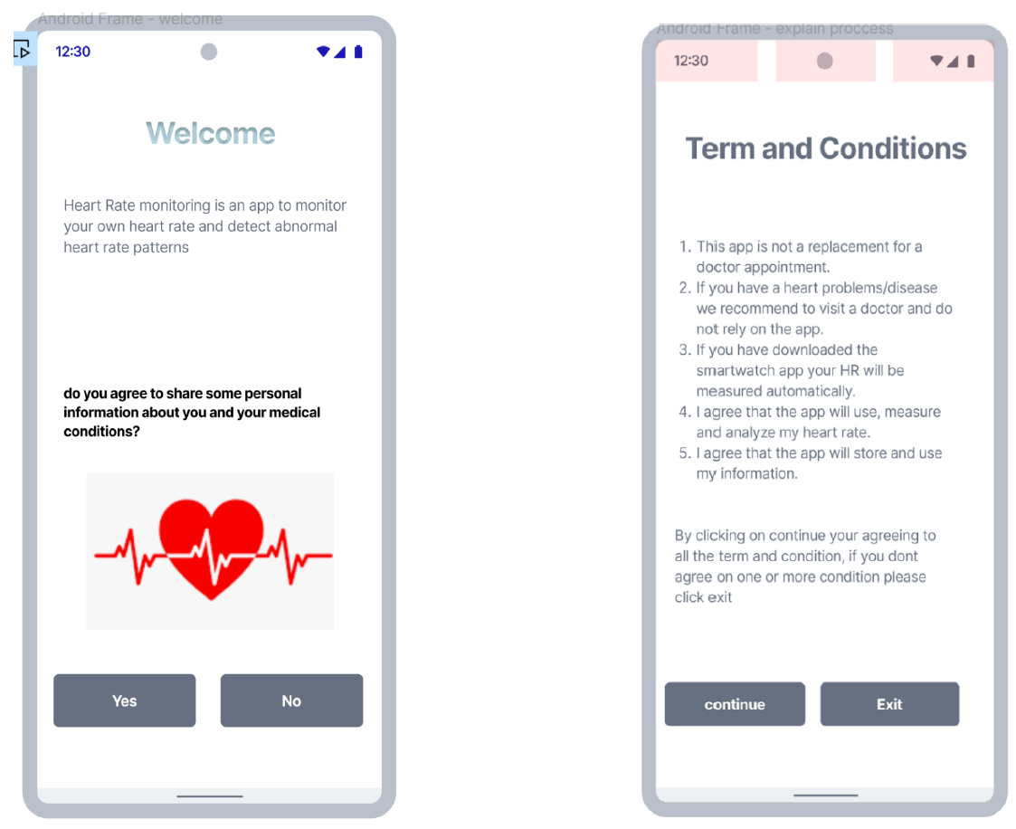
GUI

Slide 17
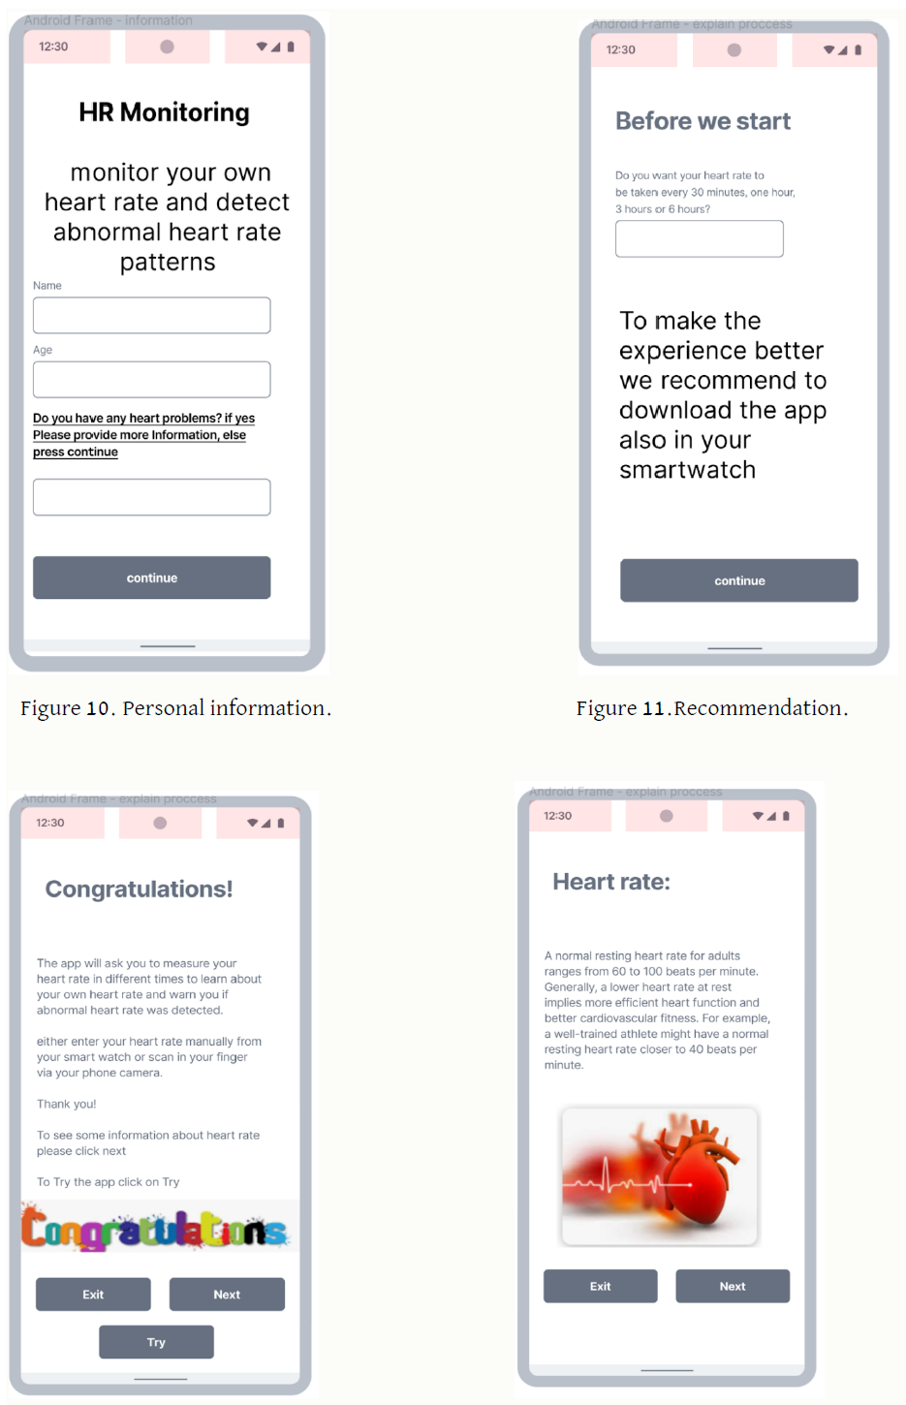
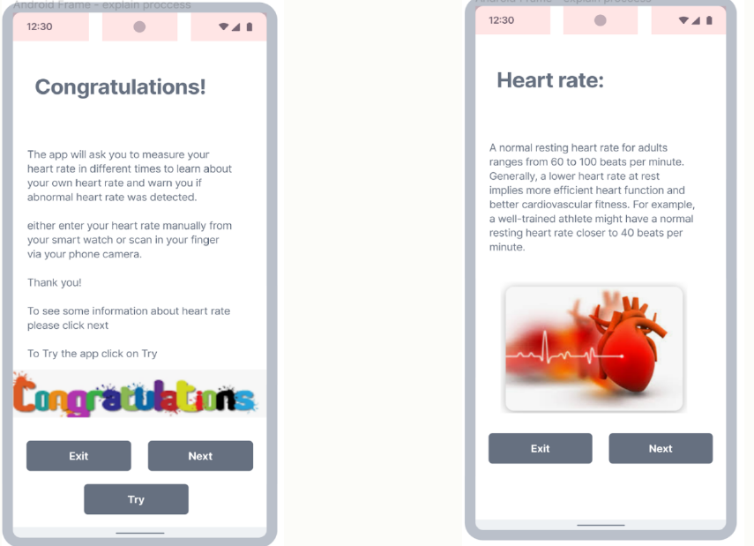

Slide 18
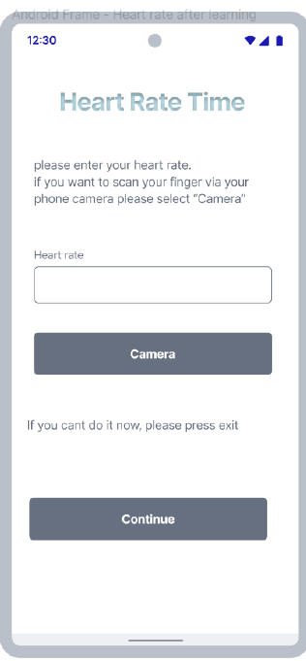
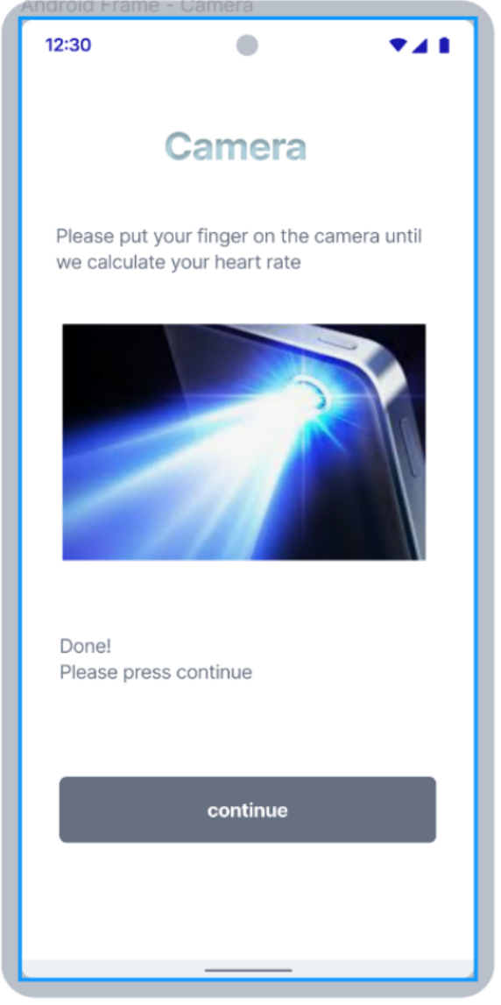
GUI: Start detecting

Slide 19
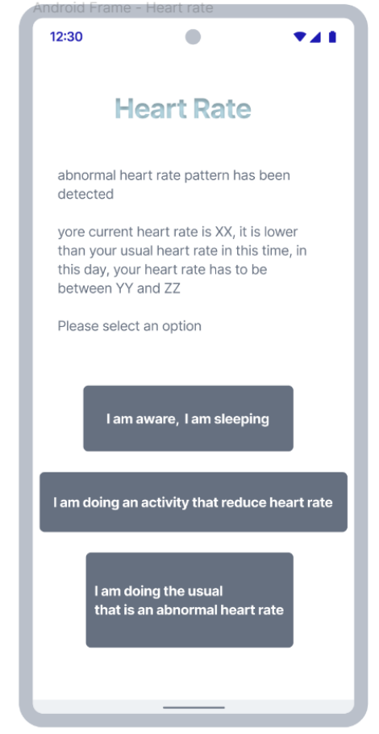
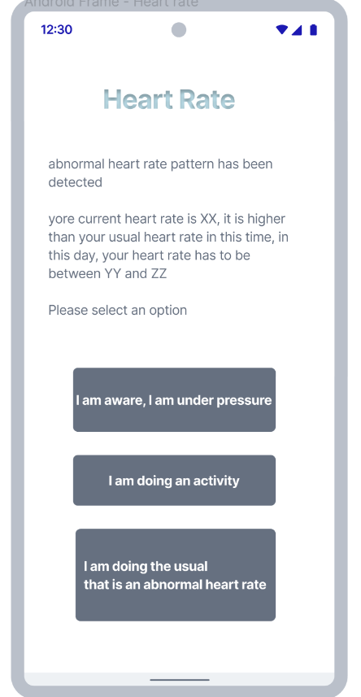
GUI: Verify the situation

Slide 20
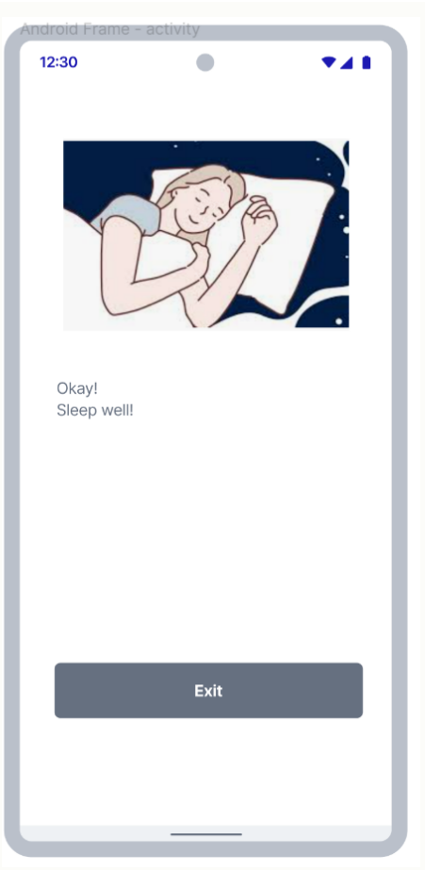
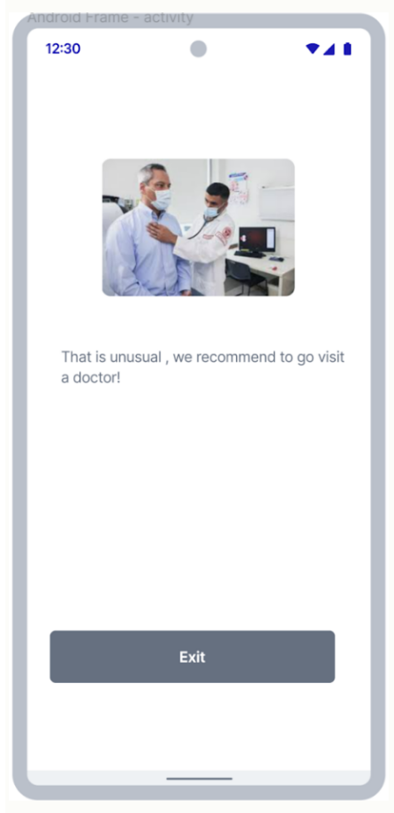
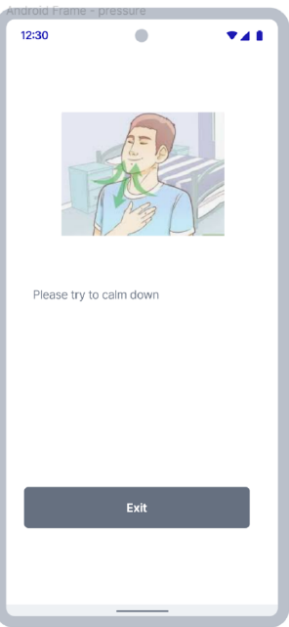

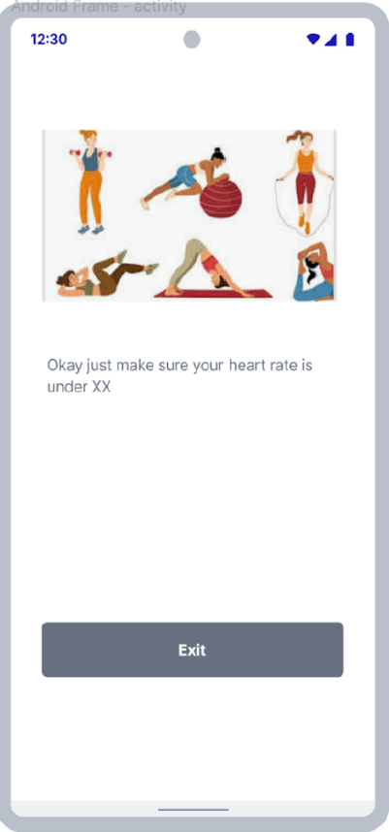
GUI: Massages

Slide 21
Testing the application
Unit Testing
Integration Testing
End-to-End Testing
Performance Testing
Load Testing
Accuracy Testing

Slide 22
Problems we may face
Data Quality and Consistency: Ensure data consistency from various consumer-grade devices.
Algorithm Accuracy: Reduce false positives and negatives through extensive testing.
Handling Diverse Data: Manage variability in heart rate patterns across different demographics, activity levels, and health conditions.
Real-Time Processing: Implement robust infrastructure and efficient algorithms for real-time data collection, processing, and analysis.

Slide 23


